Slide 1
HTML structure

Slide 2
Agenda
HTML structure
Head tag
Doctype
Body tag
Practical demonstration

Slide 3
HTML structure
Every HTML page will have tags.
HTML tags are like keywords which serve various purposes.
We have doctype to let web browser know what version of HTML we are using.
All the code we write should be between <html> </html> (html tag).
Inside HTML Tags we have <head> </head> tag and <body> </body> tag.

Slide 4
Doctype
Doctype is used to let web browser know what version of HTML we want to use.
We have to specify doctype without fail. Else, we are forcing the web browser to take a best guess of the web page and execute it.
For HTML5,
<!DOCTYPE html>
For older version of html,
<!DOCTYPE HTML PUBLIC "-//W3C//DTD HTML 4.01 Transitional//EN"
"http://www.w3.org/TR/html4/loose.dtd">

Slide 5
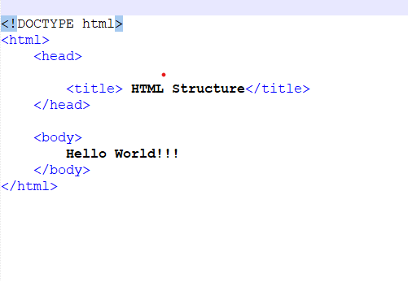
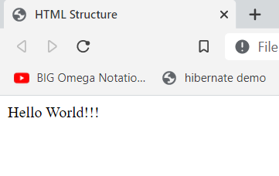
Head tag
The code written in Head tag will not be seen in the Web Page.
We can have information related to the document in head tag like title of the web page or various styles of the HTML tags or a CSS file link.
In head tag we will include the styles or design of various tags which are in body.

Slide 6
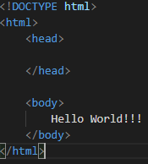

Body tag
What we write in the body will be seen on the web page.
All the tags used in the web page will be declared here. The styling of these tags can also be done here.
Sample output:

Slide 7
Practical demonstration
Let’s see practical demonstration of head and body tag.

Slide 8
Summary
Head tag contains information related to the document like title of the web page, various styles of the HTML tags in the web page.
Code written in body tag will be seen in web page.
DO NOT WRITE ANYTHING
HERE. LEAVE THIS SPACE FOR
WEBCAM

Slide 9
Thank You
Proprietary content. ©Great Learning. All Rights Reserved. Unauthorized use or distribution prohibited

